Slide 1
Chapter 7 Application Layer
Prepared By:
Prof. Vishal A. Polara
Asst. Prof.
IT Department
BVM Engg. College

Slide 2
Outline
DNS: The DNS name space, Resource records, Name servers
Electronic mail: Architecture and services, User agent, Message formats, Message transfer, Final delivery
World Wide Web: Architectural overview, HTTP

Slide 3
7.1 DNS (Domain name space)
DNS is the invention of a hierarchical, domain-based naming scheme and a distributed database system for implementing this naming scheme.
It is used because it is difficult to remember IP address.
If DNS is not there host name conflicts would occur constantly unless names were centrally managed.
It is primarily used for mapping host names and e-mail destinations to IP addresses but can also be used for other purposes

Slide 4
7.1 DNS (Domain name space
To map a name onto an IP address, an application program calls a library procedure called the resolver, passing it the name as a parameter.
resolver, gethostbyname, in The resolver sends a UDP packet to a local DNS server, which then looks up the name and returns the IP address to the resolver, which then returns it to the caller. Armed with the IP address, the program can then establish a TCP connection with the destination or send it UDP packets.

Slide 5
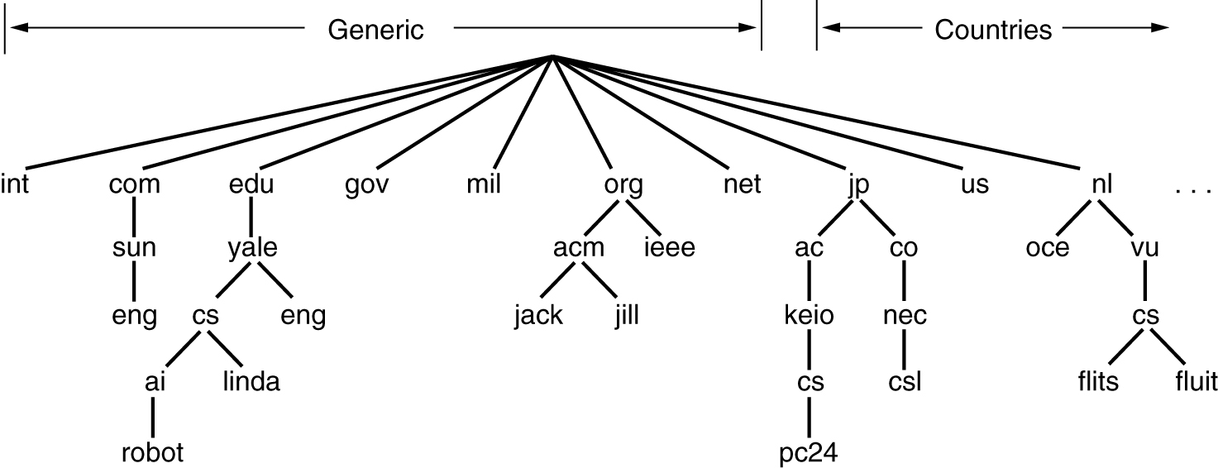
The DNS Name Space
A portion of the Internet domain name space.

Slide 6
7.1 DNS (Domain name space
the Internet is divided into over 200 top-level domains.
The top-level domains come in two flavors: generic and countries.
Domain name component are separated by . Dot.
Domain names can be either absolute or relative. An absolute domain name always ends with a period (eng.sun.com.). Relative names have to be interpreted in some context to uniquely determine their true meaning.
Domain names are case insensitive, so edu, Edu, and EDU mean the same thing. Component names can be up to 63 characters long, and full path names must not exceed 255 characters.
For example, Japan has domains ac.jp and co.jp that mirror edu and com

Slide 7
7.1 DNS (Domain name space)
For example, Japan has domains ac.jp and co.jp that mirror edu and com.
The Netherlands does not make this distinction and puts all organizations directly under nl.
Naming follows organizational boundaries, not physical networks. For example, if the computer science and electrical engineering departments are located in the same building and share the same LAN, they can nevertheless have distinct domains.

Slide 8
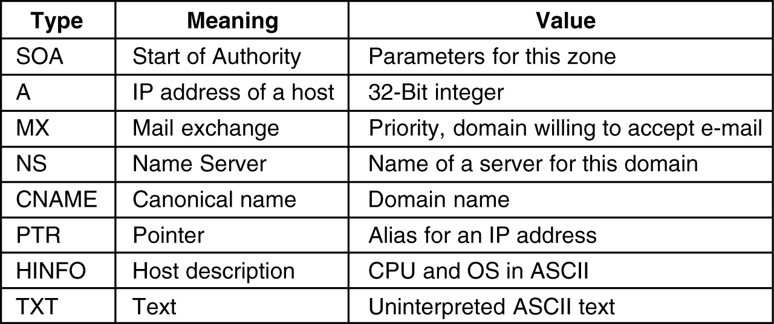
7.2 Resource Records
Format:
Domain_name Time_to_live Class Type Value
The principal DNS resource records types

Slide 9
7.2 Resource Records
Every domain, whether it is a single host or a top-level domain, can have a set of resource records associated with it. For a single host, the most common resource record is just its IP address, but many other kinds of resource records also exist.
A resource record is a five- tuple. they are encoded in binary for efficiency, In most of the case, resource records are presented as ASCII text, one line per resource record.
The Domain_name tells the domain to which this record applies.
The Time_to_live field gives an indication of how stable the record is. Information that is highly stable is assigned a large value, such as 86400 (the number of seconds in 1 day). Information that is highly volatile is assigned a small value, such as 60 (1 minute).
The third field of every resource record is the Class. For Internet information, it is always IN.
The Type field tells what kind of record this is.

Slide 10
7.2 Resource Records
An SOA record provides the name of the primary source of information . the e-mail address of its administrator, a unique serial number, and various flags and timeouts.
the A (Address) record. It holds a 32-bit IP address for some host.
the MX record specifies the name of the host prepared to accept e-mail for the specified domain. It is used because not every machine is prepared to accept e-mail. If someone wants to send e-mail to. MX will provide this information.
The NS records specify name servers. For example, every DNS database normally has an NS record for each of the top-level domains.
CNAME records allow aliases to be created. Ex. cs.mit.edu 86400 IN CNAME lcs.mit.edu.

Slide 11
7.2 Resource Records
CNAME, PTR points to another name. PTR is a regular DNS datatype whose interpretation depends on the context in which it is found. In practice, it is nearly always used to associate a name with an IP address to allow lookups of the IP address and return the name of the corresponding machine. These are called reverse lookups.
HINFO records allow people to find out what kind of machine and operating system a domain corresponds to.
TXT records allow domains to identify themselves in arbitrary ways.
the Value field. This field can be a number, a domain name, or an ASCII string.

Slide 12
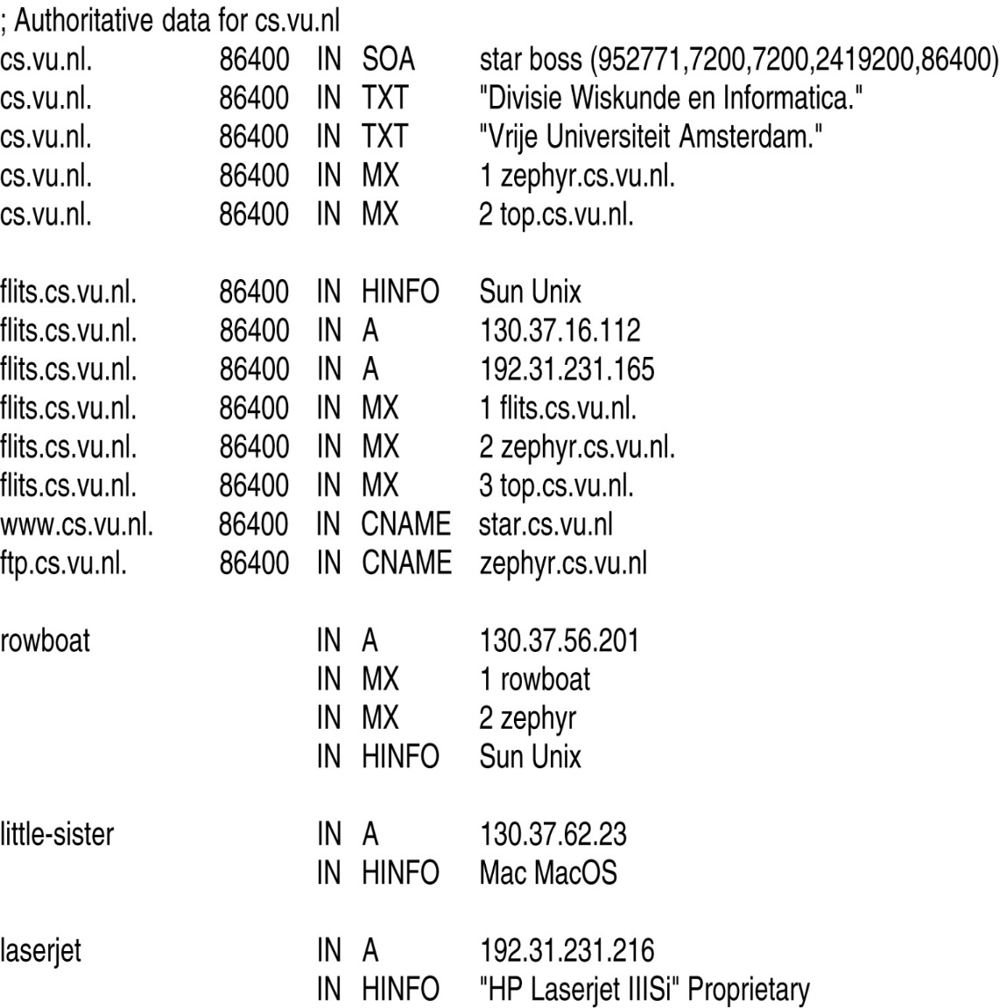
Resource Records (2)
A portion of a possible DNS database for cs.vu.nl.

Slide 13
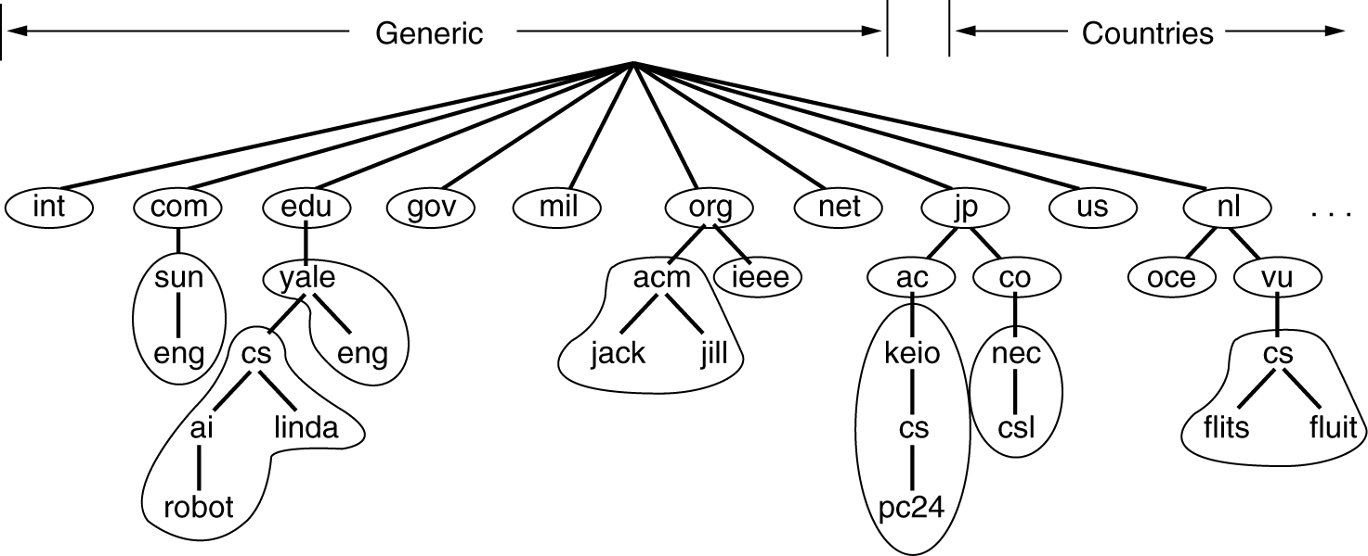
7.3 Name Servers
Part of the DNS name space showing the division into zones.

Slide 14
7.3 Name severs
a single name server could contain the entire DNS database and respond to all queries about it. There is a problem of crash.
To avoid the problems associated with having only a single source of information, the DNS name space is divided into no overlapping zones.
Each zone contains some part of the tree and also contains name servers holding the information about that zone.
Normally, a zone will have one primary name server, which gets its information from a file on its disk, and one or more secondary name servers, which get their information from the primary name server.
Where the zone boundaries are placed within a zone is up to that zone's administrator.

Slide 15
7.3 Name severs
Yale has a server for yale.edu that handles eng.yale.edu but not cs.yale.edu, which is a separate zone with its own name servers.
When a resolver has a query about a domain name, it passes the query to one of the local name servers. If the domain being sought falls under the jurisdiction of the name server, such as ai.cs.yale.edu falling under cs.yale.edu, it returns the authoritative resource records.
An authoritative record is one that comes from the authority that manages the record and is thus always correct. Authoritative records are in contrast to cached records, which may be out of date.
If, however, the domain is remote and no information about the requested domain is available locally, the name server sends a query message to the top-level name server for the domain requested.

Slide 16
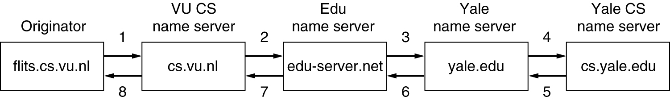
Name Servers (2)
How a resolver looks up a remote name in eight steps.

Slide 17
7.4 ELECTRONIC MAIL
One of the most popular Internet services is electronic mail (e-mail). The designers of the Internet probably never imagined the popularity of this application program. Its architecture consists of several components.
Two subsystems of Email:
User agents (UA) – local programs for command-based, menu based or graphical method interaction
Message transfer agents (MTA) – processes that run in background to move email through the system

Slide 18
First scenario
In the first scenario, the sender and the receiver of the email are users on the same system. The administrator has created one mailbox for each user where the received messages are stored.
A mailbox is part of a local hard drive, a special file with permission restrictions.

Slide 19
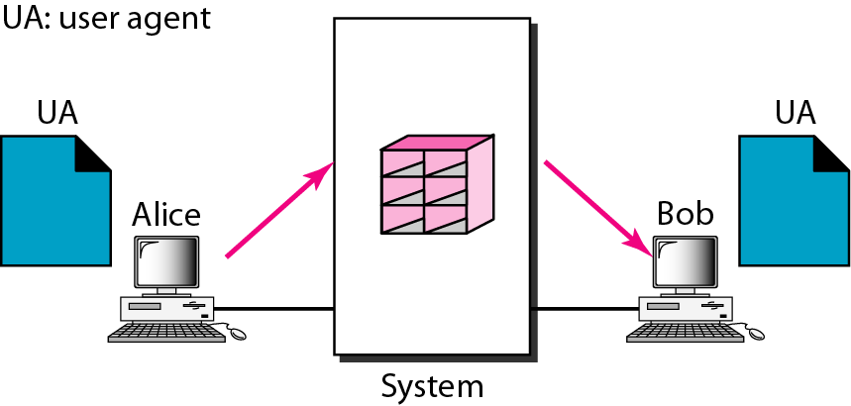
Figure First scenario in electronic mail
When the sender and the receiver of an e-mail are on the same system,
we need only two user agents.

Slide 20
Second scenario
In the second scenario the sender and the receiver of the email are users on two different systems. The message needs to be sent over the internet. Here we need user agents and message transfer agents(MTA).
we need two UAs and a pair of MTAs (client and server).
Alice need to use a user agent program to send his message to the system at his own site. The system at her site uses a queue to store messages waiting to be sent.
Now message sent through internet from alice to bob an bob will retrieve using user agent program. Serve need to run continuously while the client on the other hand can be altered by the system when there is a message in the queue to be sent.

Slide 21
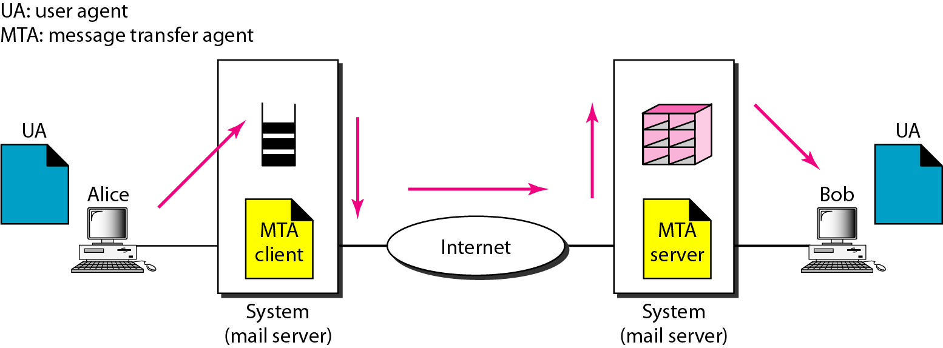
Figure Second scenario in electronic mail

Slide 22
Third scenario
Bob as in the second scenario is directly connected to his system. Alice is separated from his system. Alice is connected to the system via a point to point WAN such as a dial-up modem. Or a cable modem.
They are connected to one mail server for handling e-mails.
When the sender is connected to the mail server via a LAN or a WAN, we need two UAs and two pairs of MTAs (client and server).
When Alice want to send message. His message goes from MTA client to MTA server.

Slide 23
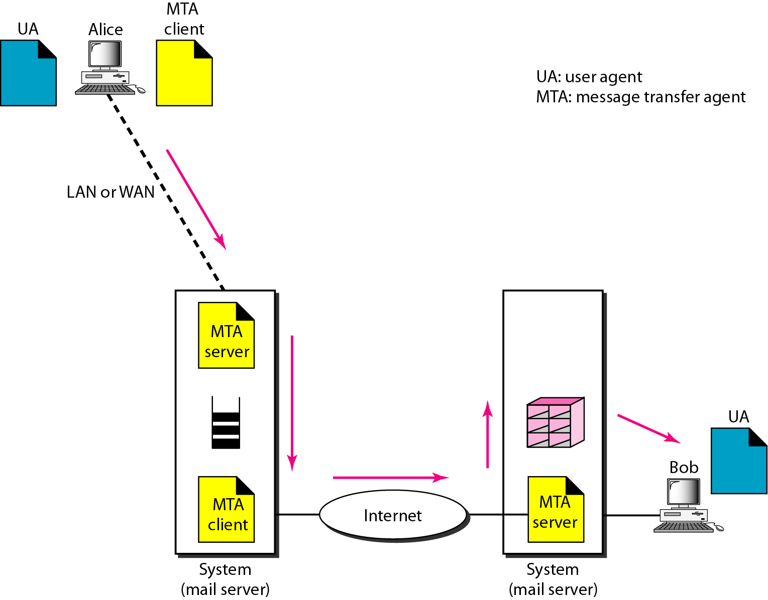
Figure Third scenario in electronic mail

Slide 24
Fourth scenario
In this scenario both are not connected directly. They are connected through LAN or WAN.
Bob need to retrieve message. We need another set of client/server agents, which we call message access agents(MAA). Bob uses an MAA client to retrieve his messages.
The client sends a request to MAA server, which is running all the time and requests the transfer of the messages.
First point here is Bob cannot by pass the mail serve and use the MTA server directly. To use MTA server directly, bob would need to run the MTA server all the time because he does not know when a message will arrive. This is not feasible today.
Second point bob needs another pair of client/server programs. Because MTA client/server program is a push program. Bob needs a pull program. Client push the message to the server.

Slide 25
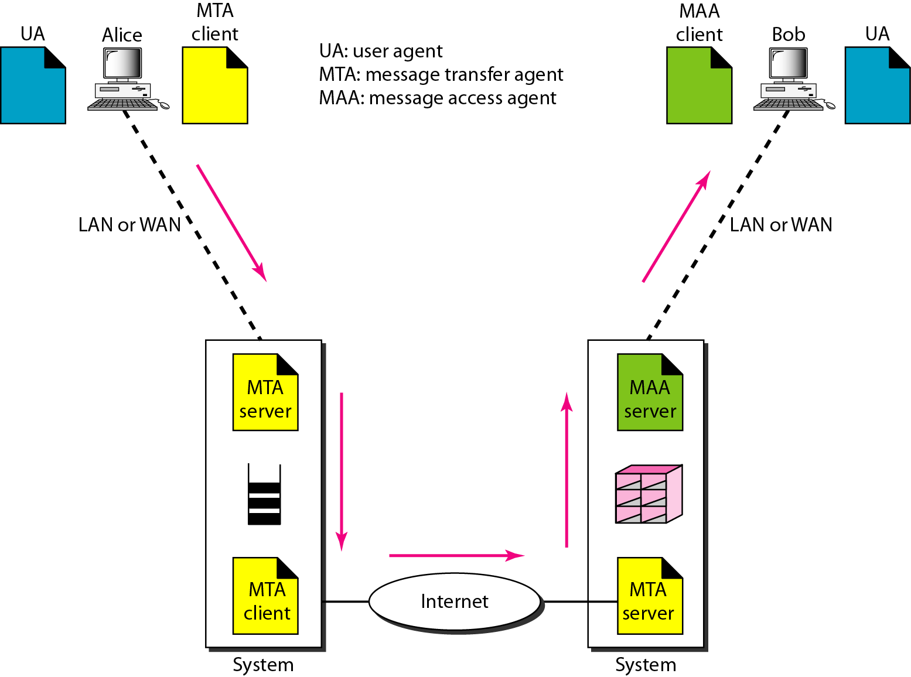
Figure Fourth scenario in electronic mail

Slide 26
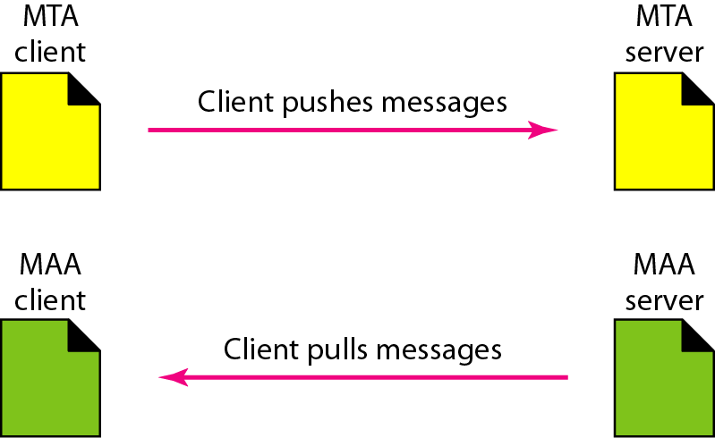
Figure Push versus pull in electronic email

Slide 27
7.4.1 Architecture and Services
It normally consists of two subsystems: user agent and message transfer agents.
User agent is command based, menu based graphical user interface. Message transfer agent will transfer message from source to destination.
It basically support five functions:
1. Composition: Creating a message.
2. Transfer: here it will send the message from source to destination.
3. Reporting: It will report about message whether it was delivered or not.
4. Displaying: It will display incoming message.
5. Disposition: it is the task that recipient do after receiving message, it will delete before reading it, or delete after reading it.

Slide 28
7.4.2 User Agent
A user agent is normally a program (sometimes called a mail reader) that accepts a variety of commands for composing, receiving, and replying to messages.
To send an e-mail message, a user must provide the message, the destination address, and possibly some other parameters.
It will also provide facility to receiver to view the message.
We can send mail to many recipient it is also facility of user agent
.

Slide 29
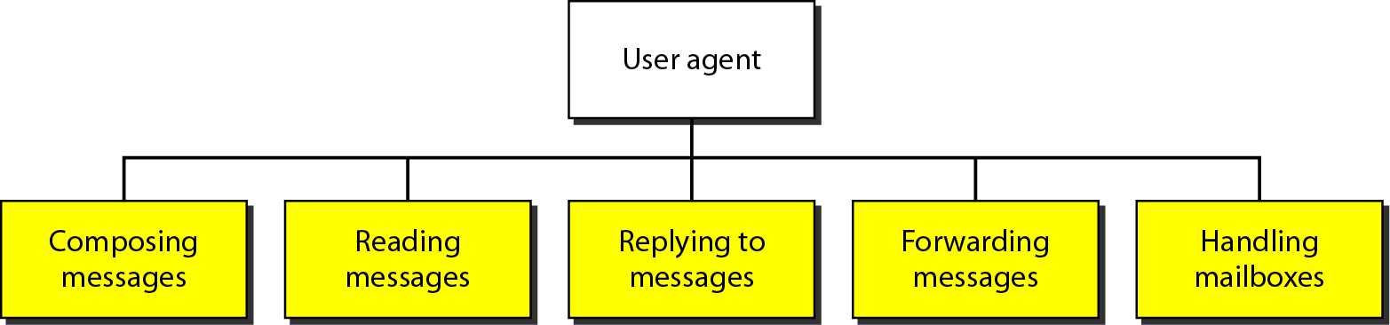
Figure Services of user agent

Slide 30
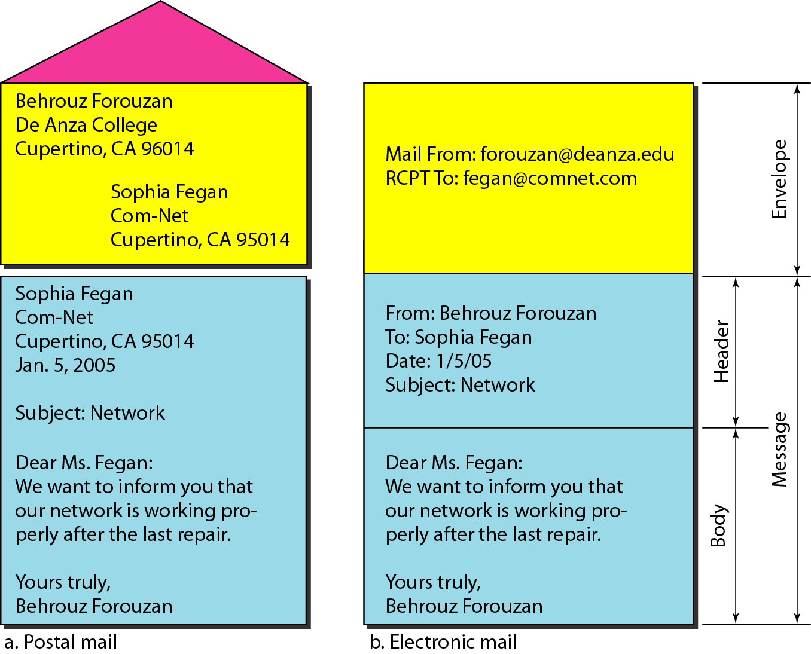
Figure Format of an e-mail

Slide 31
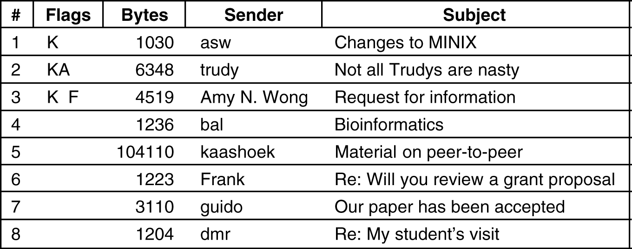
Reading E-mail
An example display of the contents of a mailbox.

Slide 32
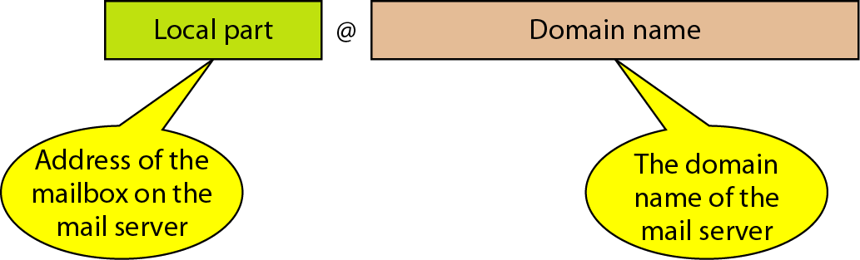
Figure E-mail address

Slide 33
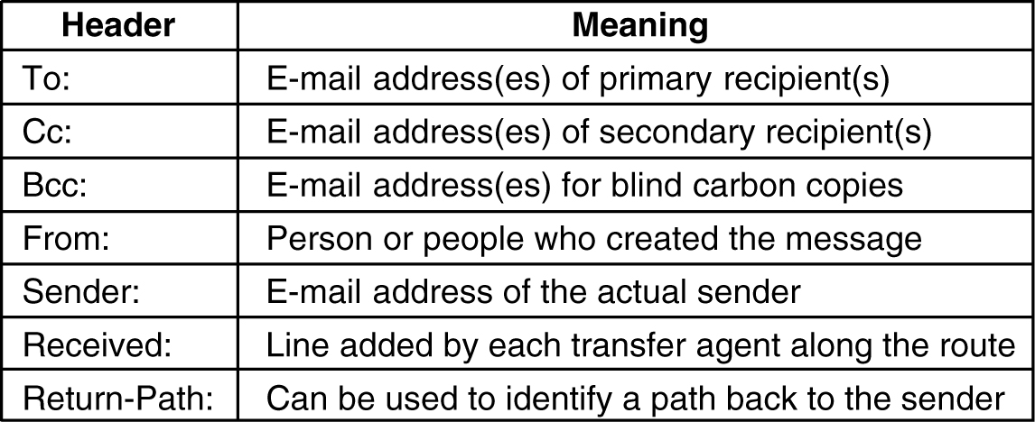
7.4.3 Message Formats – RFC 822
RFC 822 header fields related to message transport.

Slide 34
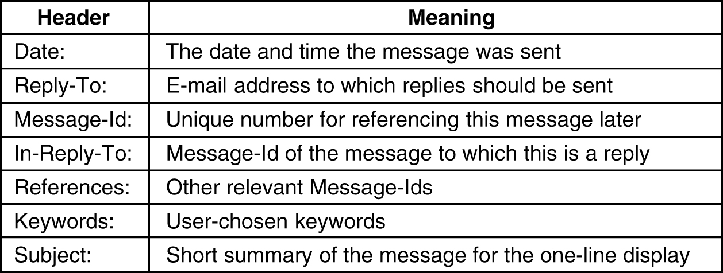
Message Formats – RFC 822 (2)
Some fields used in the RFC 822 message header.

Slide 35
MIME – Multipurpose Internet Mail Extensions
The basic idea of MIME is to continue to use the RFC 822 format, but to add structure to the message body and define encoding rules for non-ASCII messages.
Problems with international languages:
Languages with accents (French, German).
Languages in non-Latin alphabets (Hebrew, Russian).
Languages without alphabets (Chinese, Japanese).
Messages not containing text at all (audio or images).

Slide 36
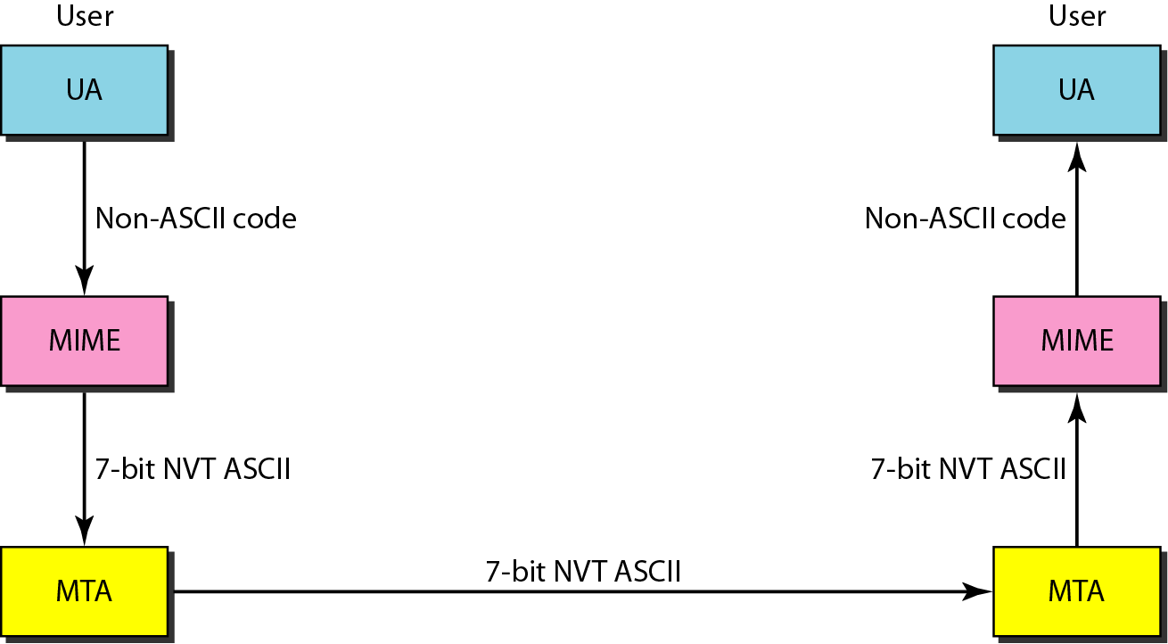
Figure MIME

Slide 37
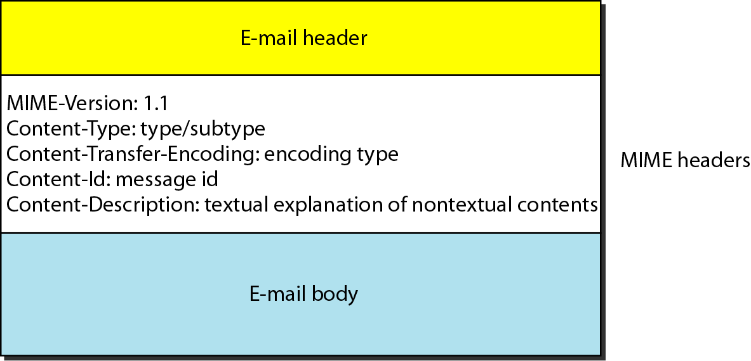
Figure MIME header

Slide 38
Table Data types and subtypes in MIME

Slide 39
Table Content-transfer-encoding

Slide 40
7.4.4 Message Transfer
The simplest way to do this is to establish a transport connection from the source machine to the destination machine and then just transfer the message.
SMTP(Simple mail transfer Protocol) is used to transfer email. e-mail is delivered by having the source machine establish a TCP connection to port 25 of the destination machine.

Slide 41
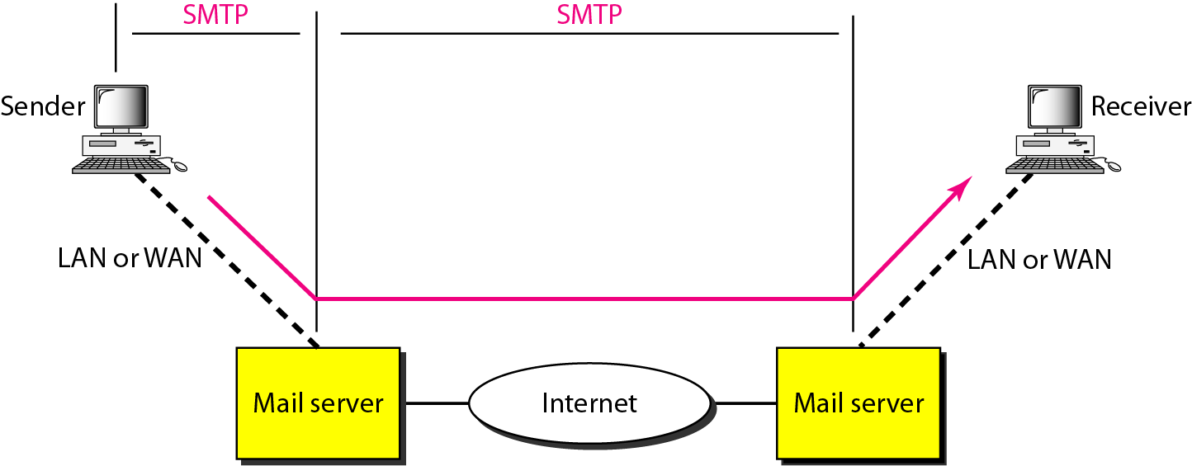
7.4.4 Message Transfer
Figure SMTP range

Slide 42
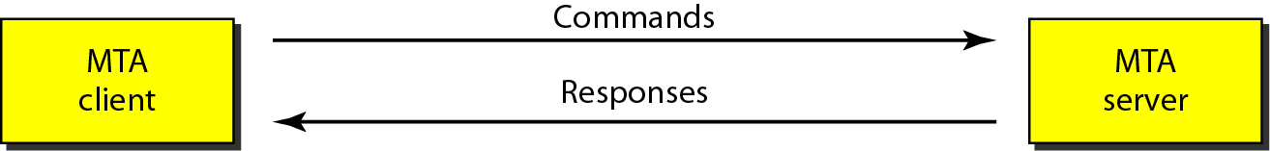
Figure Commands and responses

Slide 43

Figure Command format

Slide 44
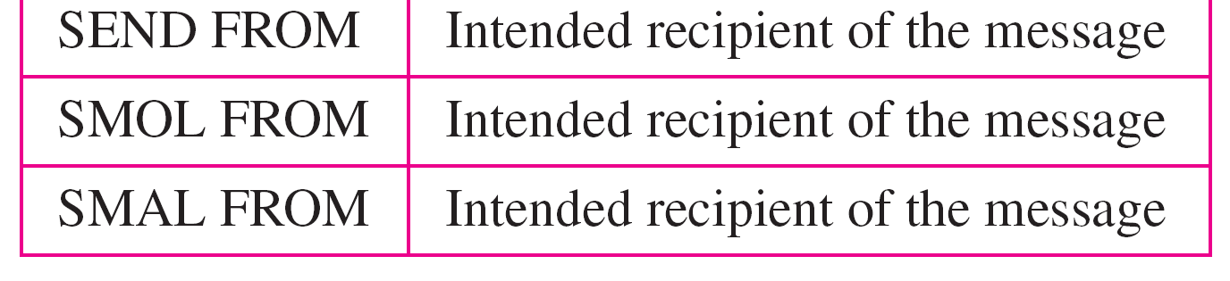
Table 14 Commands from client to server

Slide 45
Table Responses from server to client

Slide 46
Table Responses (continued)

Slide 47
7.4.5 Final Delivery
we have assumed that all users work on machines that are capable of sending and receiving e-mail.
what happens when Elinor wants to send Carolyn e-mail and Carolyn is not currently on-line? Elinor cannot establish a TCP connection to Carolyn and thus cannot run the SMTP protocol.
One solution is to have a message transfer agent on an ISP machine accept e-mail for its customers and store it in their mailboxes on an ISP machine. Since this agent can be on-line all the time, e-mail can be sent to it 24 hours a day.
The solution to this problem is to create another protocol that allows user transfer agents (on client PCs) to contact the message transfer agent (on the ISP's machine) and allow e-mail to be copied from the ISP to the user. One such protocol is POP3 (Post Office Protocol Version 3)

Slide 48
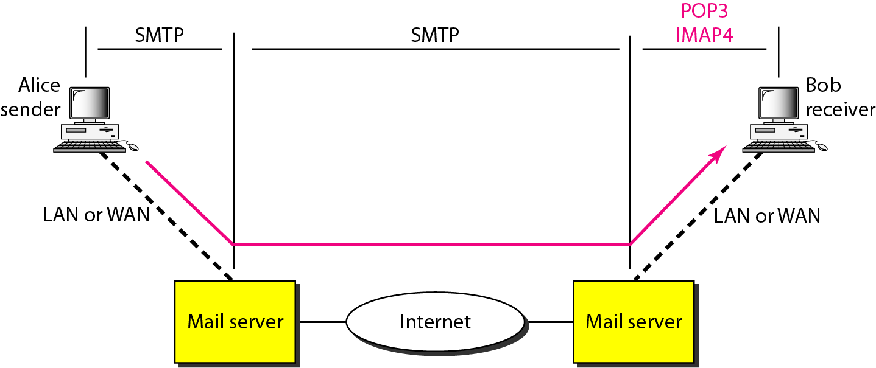
Final Delivery
Figure POP3 and IMAP4

Slide 49
7.4.5 Final Delivery
The first and the second stages of mail delivery use SMTP. However, SMTP is not involved in the third stage because4 SMTP is a push protocol.
It pushes the message from the client to the server. Direction of the bulk data from client to the server.
The third stage needs a pull protocol. The client must pull messages from the server. The direction of bulk data is from the server to the client. the third stage uses a message access agent.
Currently two message access protocol are available: Post office Protocol , version 3 and Internet mail access protocol, version 4.

Slide 50
7.4.5 Final Delivery (POP3)
POP3 begins when the user starts the mail reader. The mail reader calls up the ISP (unless there is already a connection) and establishes a TCP connection with the message transfer agent at port 110. Once the connection has been established, the POP3 protocol goes through three states in sequence:
Authorization: deals with having the user log in
Transactions: deals with the user collecting the e-mails and marking them for deletion from the mailbox
Update: actually causes the e-mails to be deleted.
It has two mode delete mode and the keep mode. In the delete mode the mail is deleted from the mailbox after each retrieval. In the keep mode, the mail remains in the mailbox after retrieval. The delete mode is used when user is on his computer. Keep mode is used when user accessing from others computer.

Slide 51
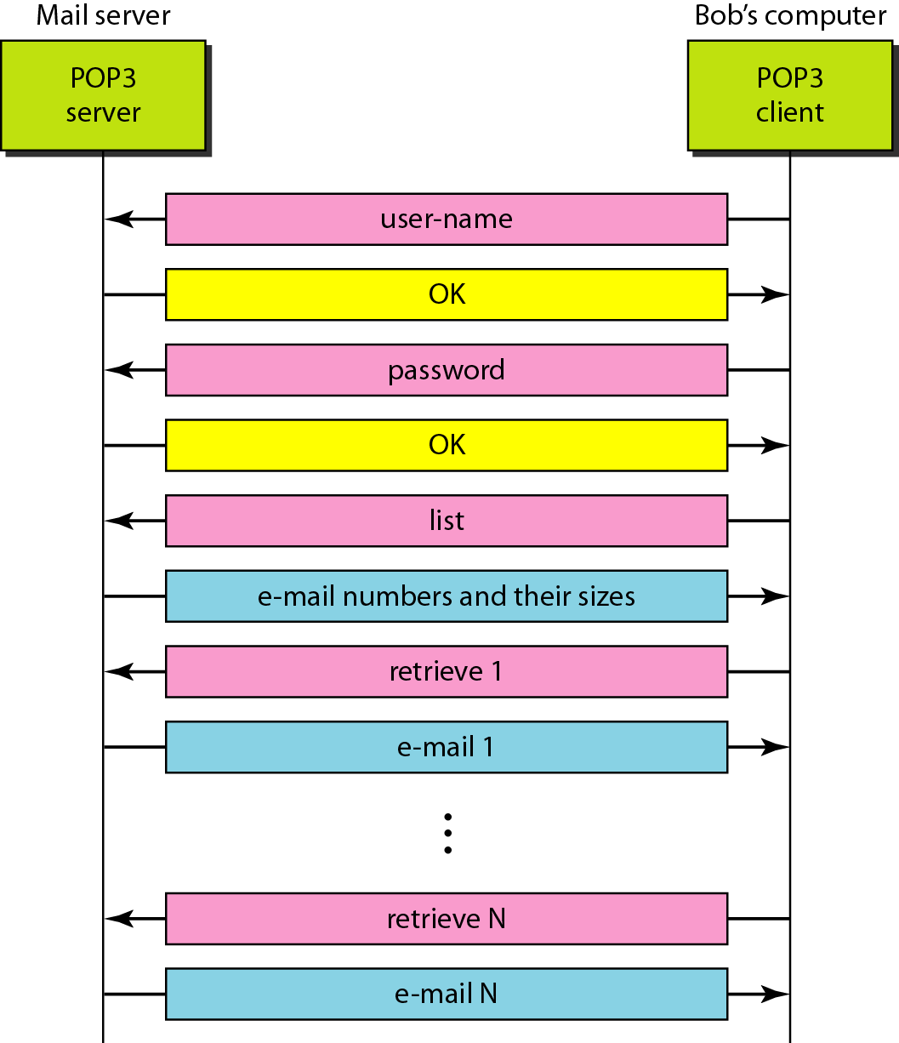
Figure The exchange of commands and responses in POP3

Slide 52
IMAP
IMAP (Internet Message Access Protocol), which is defined in RFC 2060. Unlike POP3, which basically assumes that the user will clear out the mailbox on every contact and work off-line after that, IMAP assumes that all the e-mail will remain on the server indefinitely in multiple mailboxes.
IMAP provides extensive mechanisms for reading messages or even parts of messages, a feature useful when using a slow modem to read the text part of a multipart message with large audio and video attachments.
Since the working assumption is that messages will not be transferred to the user's computer for permanent storage, IMAP provides mechanisms for creating, destroying, and manipulating multiple mailboxes on the server. In this way a user can maintain a mailbox for each correspondent and move messages there from the inbox after they have been read.

Slide 53
IMAP
IMAP4 is more powerful and more complex.
POP3 does not allow the user to organize his mail on the server the user cannot have different folders on the server.
POP3 does not allow the user to partially check the contents of the email before downloading.
IMAP4 provides the following extra functions:
1. A user can check the email header prior to downloading.
2. A user can search the contents of the email for a specific string of characters prior to downloading.
3. A user can partially download email.
4. A user can create, delete, or rename mailboxes on the mail server.
5. A user can create a hierarchy of mailboxes in a folder for email storage.

Slide 54
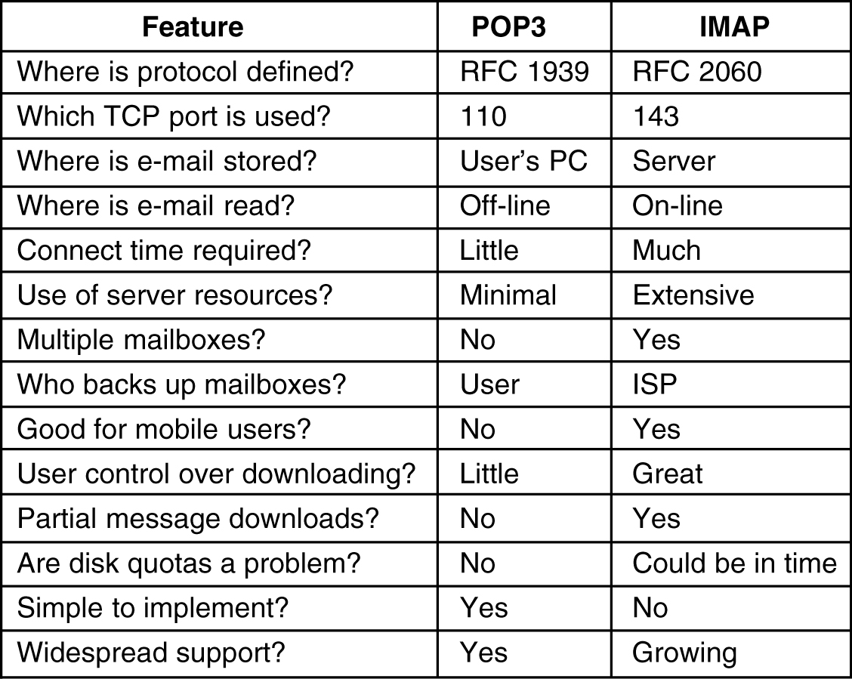
A comparison of POP3 and IMAP

Slide 55
7.5 World Wide Web (WWW)
The WWW today is a distributed client/server service, in which a client using a browser can access a service using a server. However, the service provided is distributed over many locations called sites.

Slide 56
7.5 WWW
It is a repository of information linked together from points all over the world.
WWW has a unique combination of flexibility , portability and user –friendly feature.
It is a distributed client/server service, in which a client using a browser can access a service using a server.
The service provided is distributed over many locations called sites. Each sites holds one or more documents, referred to as web pages. Each web page can contain a link to other pages in the same site or at other sites. Page can be view using browsers.

Slide 57
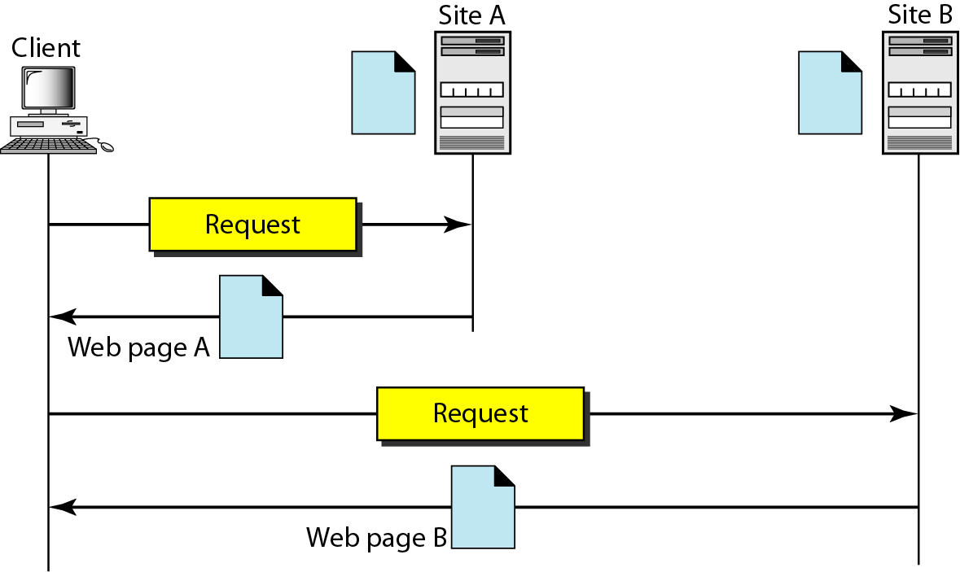
Figure Architecture of WWW

Slide 58
Browser(client)
Each browser consists of three part: a controller, client protocol and interpreters.
The controller receives input from the keyboard or the mouse and uses the client programs to access the document.
After accessing document the controller uses one of the interpreters to display the document on screen.

Slide 59
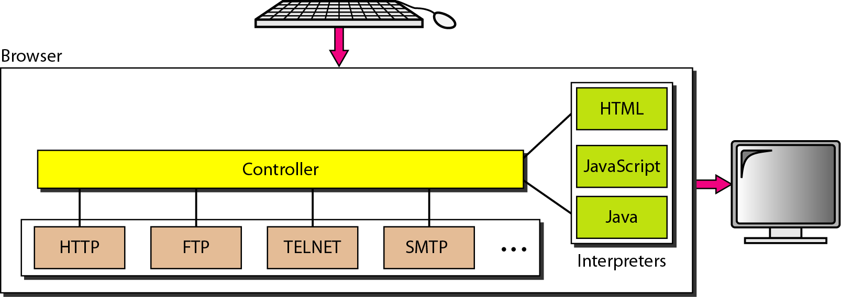
Figure Browser

Slide 60
Server and Uniform Resource Locator
Server is used to send document to client on request.
A client that wants to access a web page needs the address.
The uniform resource locator is a standard for specifying any kind of information on the internet.
The protocol is the client/server program used to retrieve the document.
The host is the computer on which the information is located.
The port is port available on computer.
The path is the pathname of the file where the information is located.

Slide 61
Figure URL

Slide 62
7.5.1 Web Documents
There are three types of documents: static, dynamic and active.
Static Documents: It is fixed content documents that are created and store in a server.
The client can get only a copy of the document. It can not change when it is used.
Ex. HTTP language is used to create static doc.
Dynamic documents: It is created by a web sever whenever requests the document.
When an application arrives application program or a script that create the dynamic document.
Ex. Common gateway interface(CGI) used to create dynamic documents.

Slide 63
Active documents: the program or script which is require to run some program at client side is called active documents.
It is also known as client side dynamic documents.
for example a program that creates animated graphics on the screen or a program that interacts with the user. This types of program needs to be run at the client site where the animation or interaction take place.
For example. Java applet is used to create active documents.

Slide 64
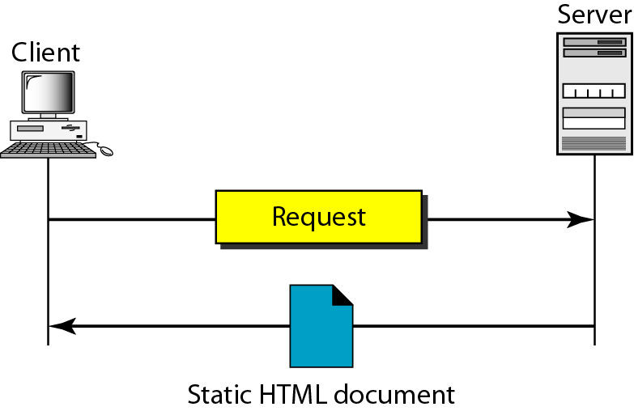
Figure Static document

Slide 65
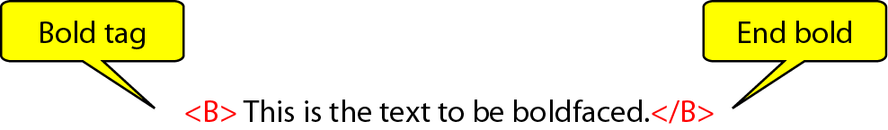
Figure Boldface tags

Slide 66
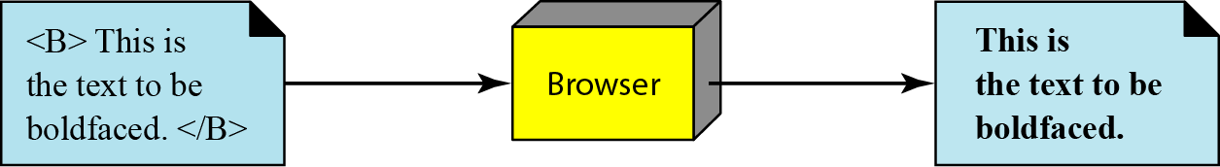
Figure Effect of boldface tags

Slide 67
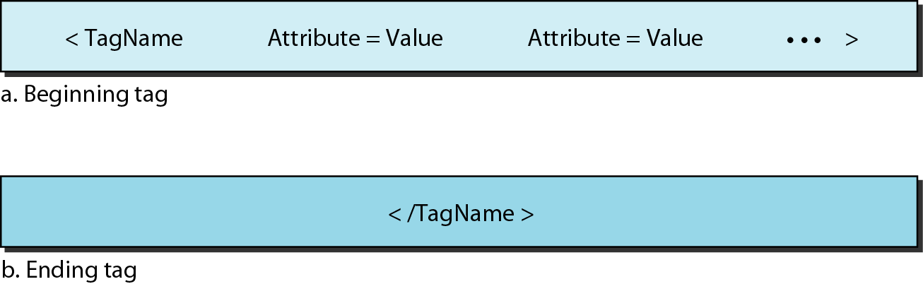
Figure Beginning and ending tags

Slide 68
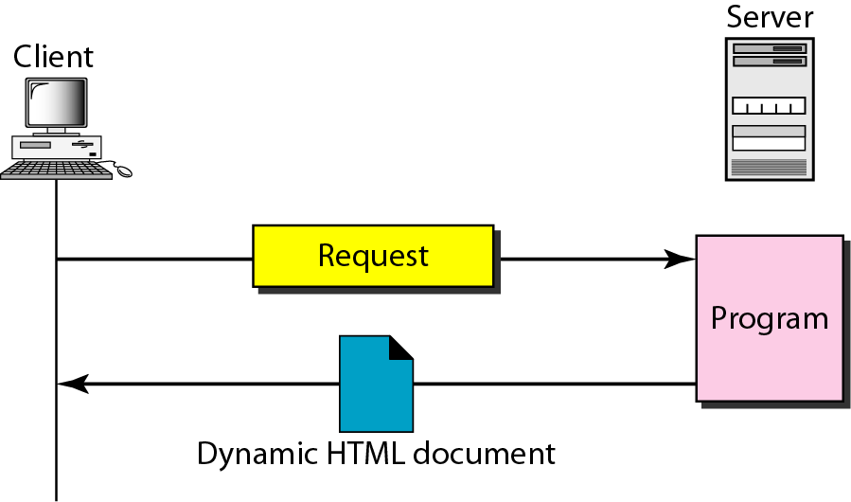
Figure Dynamic document using CGI

Slide 69
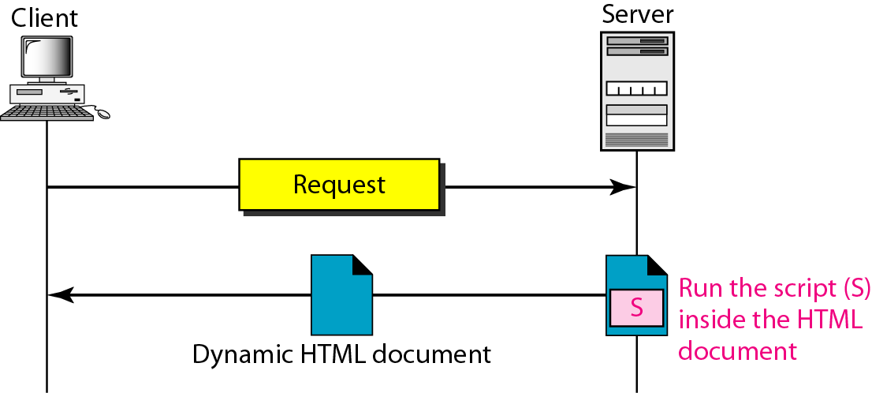
Figure Dynamic document using server-site script

Slide 70
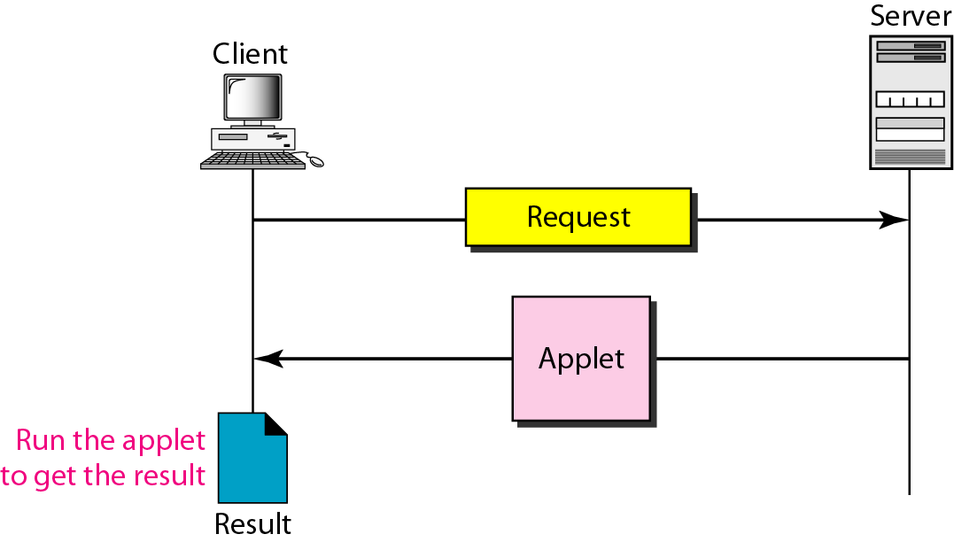
Figure Active document using Java applet

Slide 71
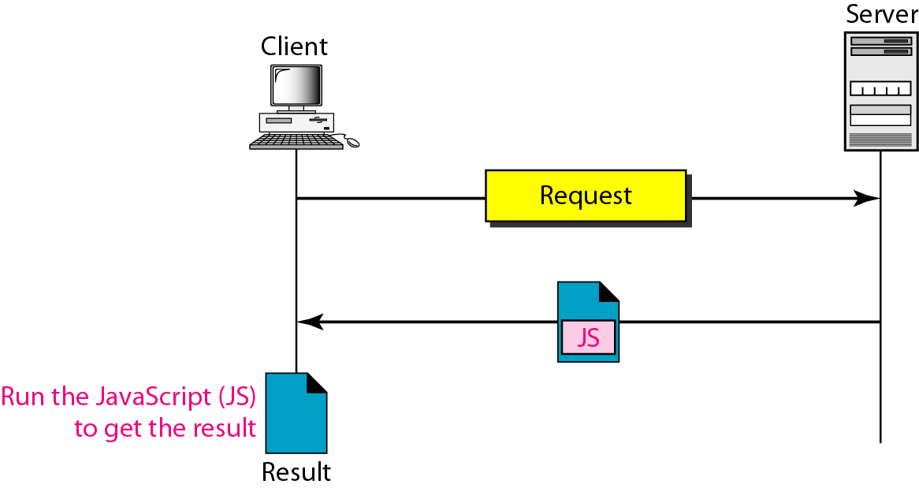
Figure Active document using client-site script

Slide 72
7.5.2 HTTP
It is a Hyper text transfer protocol (HTTP) used mainly to access data on the world wide web. It is a stateless protocol.
It function as a combination of FTP and SMTP. It is similar to FTP because it transfers files and uses the services of TCP. It is simpler than FTP because it uses only one TCP connection. No separate control connection only data transfer take place.
HTTP is like SMTP because the data transferred between the client and the sever look like SMTP messages.
SMTP messages are stored and forward but HTTP messages are delivered immediately.
HTTP uses the services of TCP on well-known port 80.

Slide 73
HTTP transaction
The client initializes the transaction by sending a request message. The server replies by sending response.
The format of the request and response messages are similar. A request message consists of a request line, a header and sometimes a body. A response message consists of a status line, a header and sometimes a body.
Request and Status line: The first line in a request message is called a request line, the first line in the response message is called the status line.
Request type: It is defined as per the format.
URL: as per the previous topic.
Version: The most current version of HTTP is 1.1.
Status code: It consists of three digits.
Status phrase: this field is used in the response message. It explains the status code in text form.

Slide 74
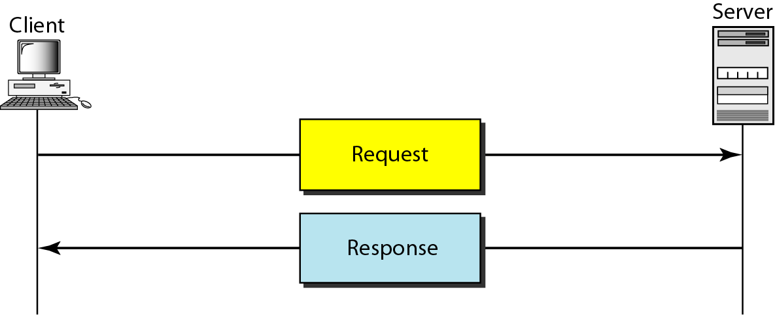
Figure HTTP transaction

Slide 75
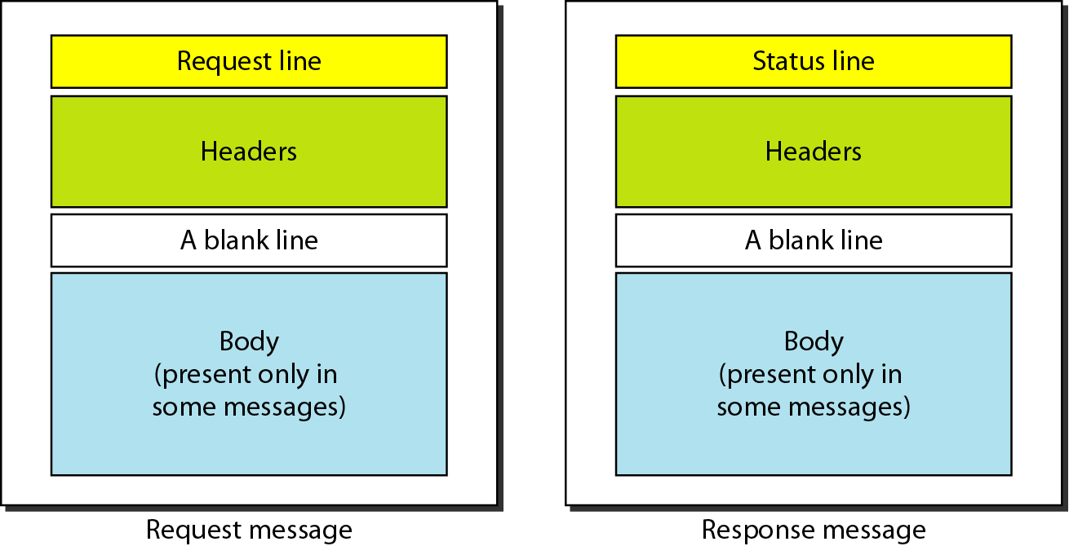
Figure Request and response messages

Slide 76
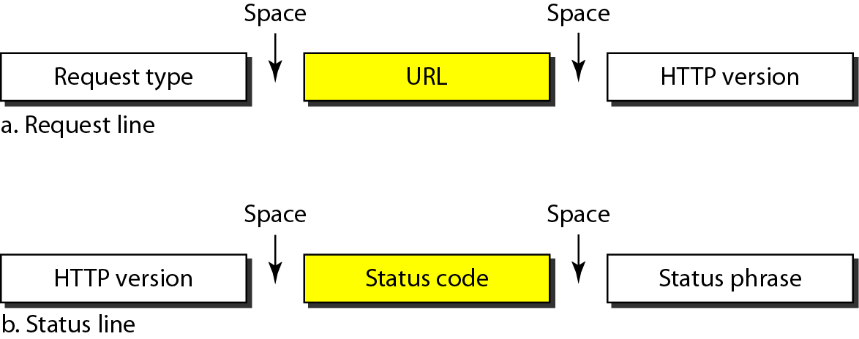
Figure Request and status lines

Slide 77
Table Methods of Request type

Slide 78
Table Status codes

Slide 79
Table Status codes (continued)

Slide 80
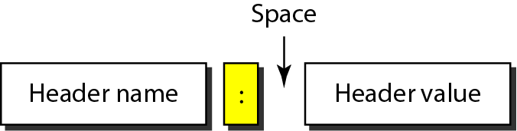
Figure Header format
Header Types
Entity header
General header
Request header
Response header

Slide 81
HTTP header
It is used to exchange additional information between client and server. The header can consists of one or more header lines. Each header line has a header name, a colon, a space, and a header value.
A header line belongs to one of four categories: General heeder, request header, response header and entity header.
A request message contain only general, request and entity headers. A response message contain general, response and entity headers.
General Header: It gives general information about the message and can be present in both a request and a response.
Request header: It specifies the client’s configuration and the client’s preferred document format.
Response header: It specifies the server’s configuration and special information about the request.
Entity header: It gives information about the body of the document.

Slide 82
HTTP header
Response header: It specifies the server’s configuration and special information about the request.
Entity header: It gives information about the body of the document.
Body: It can be present in a request or response message. It contains the document to be sent or received.

Slide 83
Table General headers

Slide 84
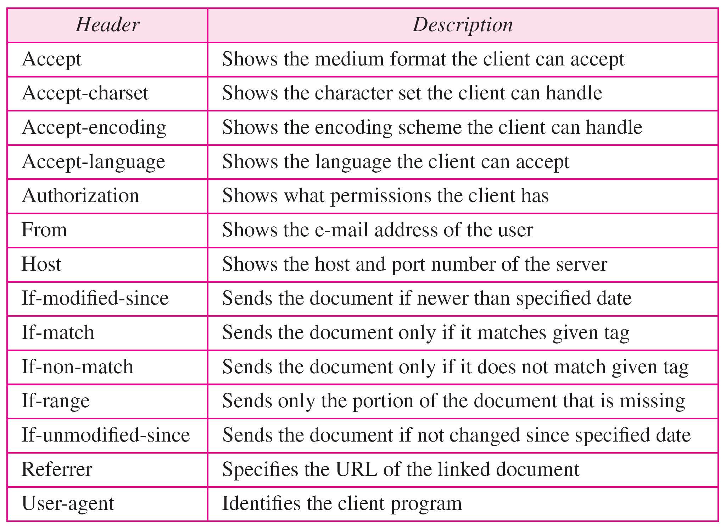
Table Request headers

Slide 85
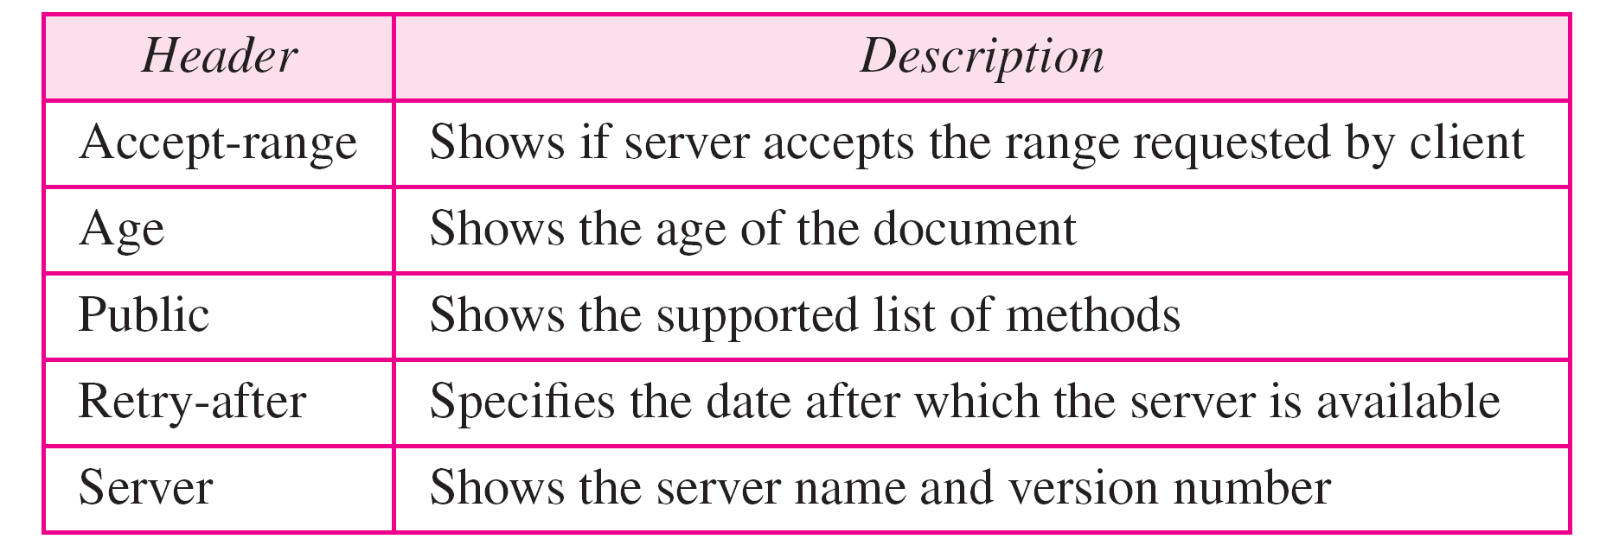
Table Response headers

Slide 86
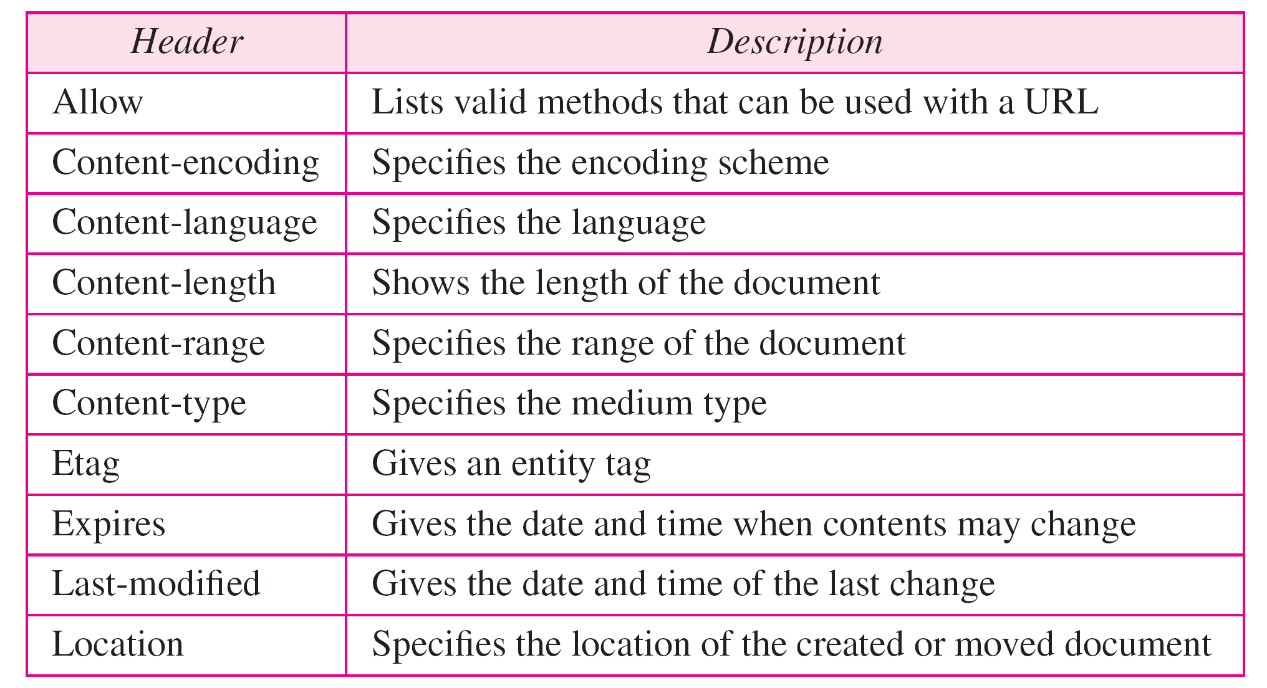
Table Entity headers

Slide 87
Persistent Versus Nonpersistent Connection
In a nonpersistent connection, one TCP connection is made for each request/response.
The following lists the steps in this strategy:
1. The client opens a TCP connection and sends a request.
2. The server sends the response and closes the connection.
3. The client reads the data until it encounters an end-of-file marker; it then closes the connection.
In a persistent connection, the server leaves the connection open for more requests after sending a response.
The server can close the connection at the request of a client or if a time-out has been reached.
HTTP version 1.1 specifies a persistent connection by default.

Slide 88
Proxy Server
HTTP supports proxy servers.
A proxy server is a computer that keeps copies of responses to recent requests.
The HTTP client sends a request to the proxy server. The proxy server checks its cache.
If the response is not stored in the cache, the proxy server sends the request to the corresponding server. Incoming responses are sent to the proxy server and stored for future requests from other clients.
The proxy server reduces the load on the original server, decreases traffic, and improves latency.
To use the proxy server, the client must be configured to access the proxy instead of the target server.

Slide 89
Thank You

